Slide 1

Case File: Cracking the Code of Workplace Violence in Hospital
DS5110 Introduction of Data Management
Team Member: Yueheng Yuan, Muyang Cheng, Wenyi Ye
Notes:
Slide 1: 40s
Hi everyone, we are the medical team.
Violence against healthcare is becoming a common topic since COVID.
You may think about Luigi, but today we'll focus on those happened in hospitals.
In this project, we’ll analyze where, when, and why violence happens, and most importantly, how to mitigate it.
This isn’t just about numbers; it’s about protecting people who save others. So let’s begin.

Slide 2

Prep Time
Background
"1 in 3 nurses experience workplace violence annually"
Why This Project?
Safety: Protect staff/patients
Prevention: Identify high-risk scenarios
Action: Advocate for policy changes
What We Did?
Data Preprocessing → ML → EDA → ML/Semantic Analysis → Policy Recommendations
https://edition.pagesuite.com/popovers/dynamic_article_popover.aspx?artguid=621e2c49-cc12-4c9d-ae5a-256f585eb81e&appcode=BOSGLO&eguid=a36d36f8-c987-4b93-81a1-d378a73f20d7&pnum=106#
Notes:
Slide 2: 25s
A brief introduction about our workflow: we started by merging the given 9 datasets, clean and map into number, performing ML and semantic analysis, then combine for results.
https://edition.pagesuite.com/popovers/dynamic_article_popover.aspx?artguid=621e2c49-cc12-4c9d-ae5a-256f585eb81e&appcode=BOSGLO&eguid=a36d36f8-c987-4b93-81a1-d378a73f20d7&pnum=106#

Slide 3

Clues Collected
What’s in the Dataset?
1517 incidents from 2024 to 2025
Key Columns:
`Event date`, `Facility Type`, `Department/Office Incident Took Place`, `Occupational Category of Person Affected`, `Aggressor`, `Type of Violence`, `Severity of Assault`, `Primary Contributing Factors`, `Primary Assault Description`, `Assault Description`, `Response Action Taken`
What do We Focus?
Predict severity, identifying high-risk roles/locations, and extracting hidden themes from incident narratives
Notes:
Slide 3: 25s
Across the dataset, we spotted 1517 valid cases since last year. (which is surprising to me given we are in Maine)
Next we will predict severity, identifying high-risk roles/locations, and extracting hidden themes from descriptions.

Slide 4
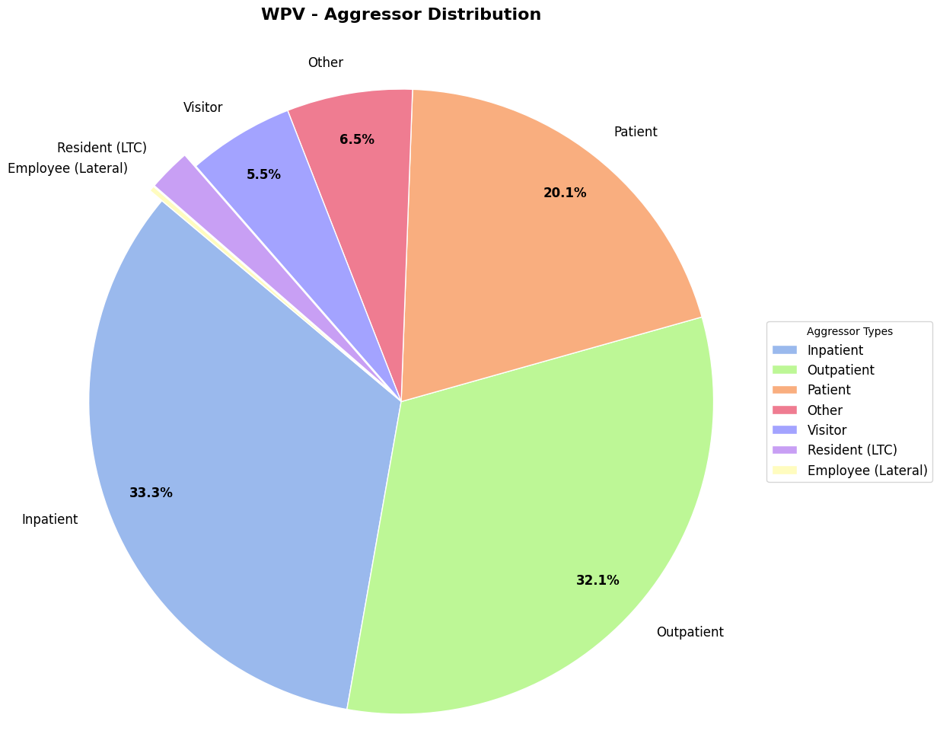
Who Dunnit?
Notes:
Slide 4: 15s
To begin with, let’s ask a quick question: who dunnit?
As we can see, over 80% of violence is done by patients.
(Inpatient: stay overnight in a hospital for treatment; outpatient: without staying overnight)

Slide 5
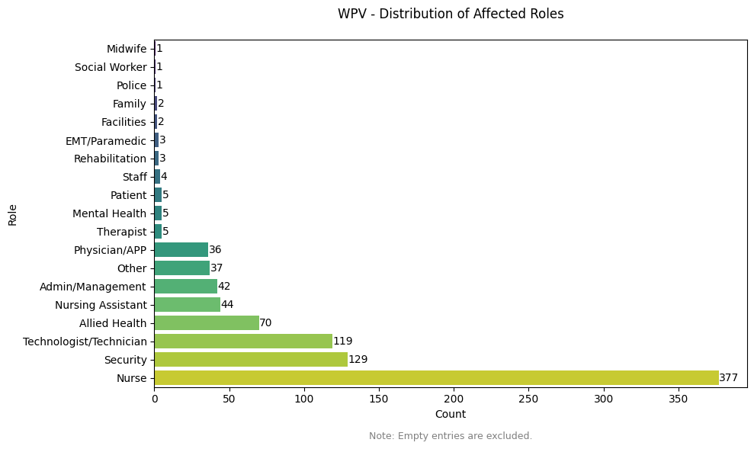
Who Dunnit?
Notes:
Slide 5: 5s
And unfortunately, nurses are the most impacted healthcare professions.
--------------------------------------
Answer Text Q3: Which healthcare professions are most impacted by violence?
Mention the difficulty of processing those data, as multiple role are filled in one field, so we have to use regex to separate them

Slide 6

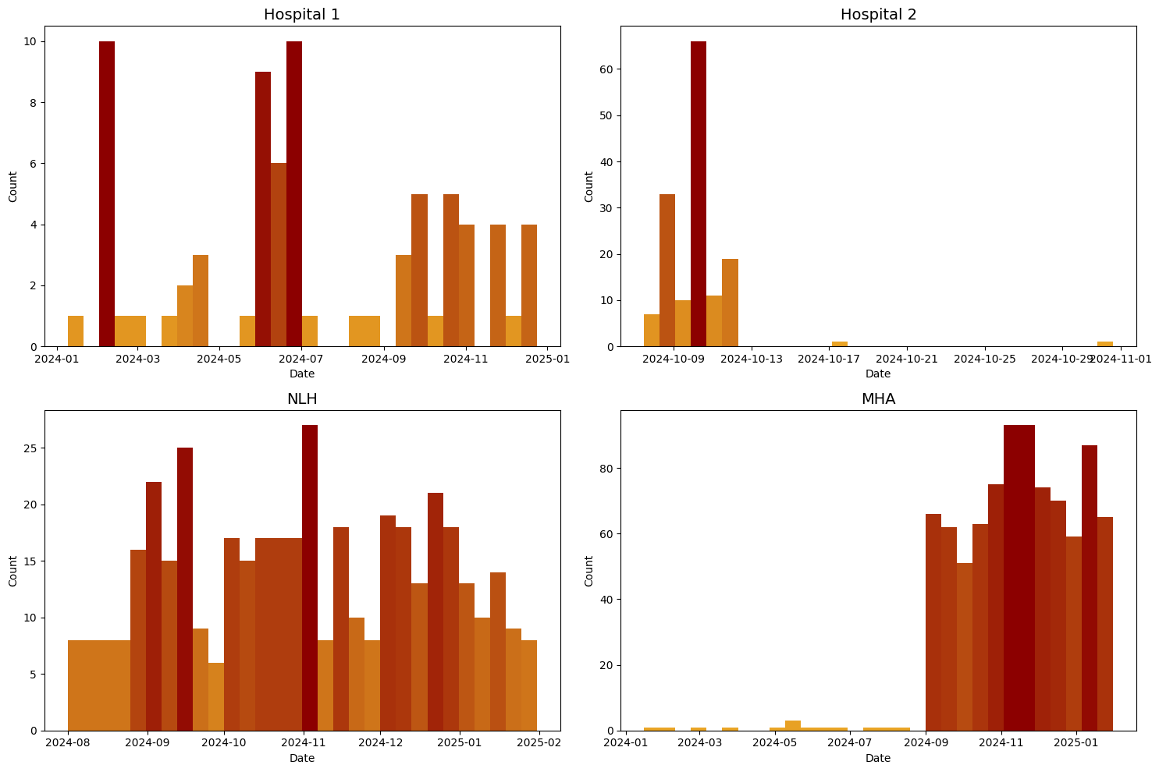
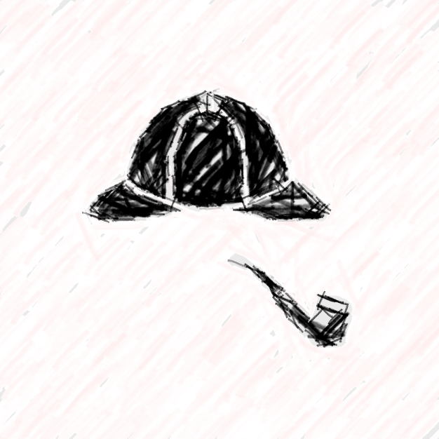
When Dunnit?
Notes:
Slide 6 10s
This leads to the next question, when those violence is more likely to happen?
Each hospital shows a different pattern in terms of months,

Slide 7

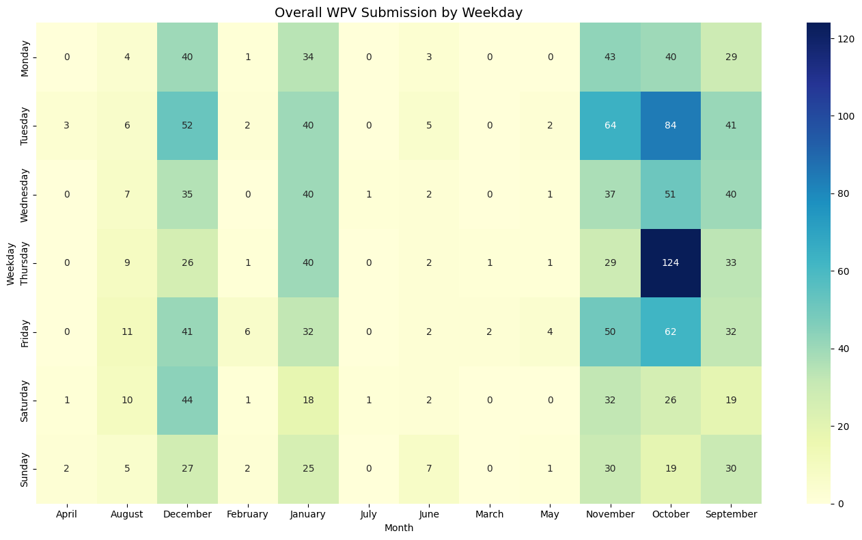
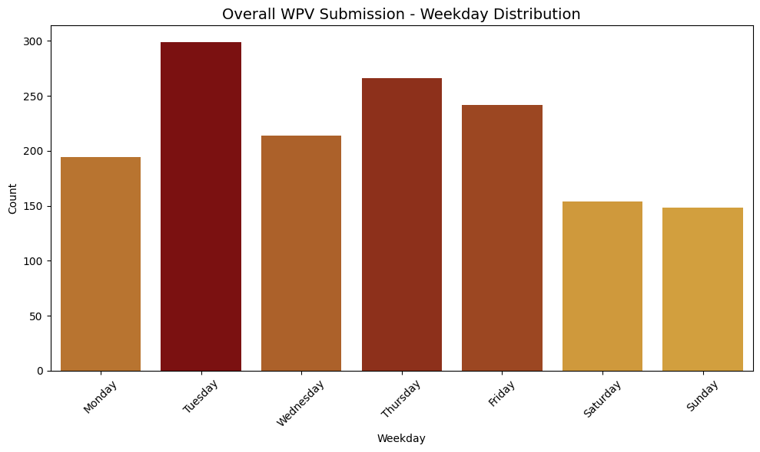
When Dunnit?
Notes:
Slide 8: 10s
When we combine them together, we can spot a higher tendency at business days.

Slide 8
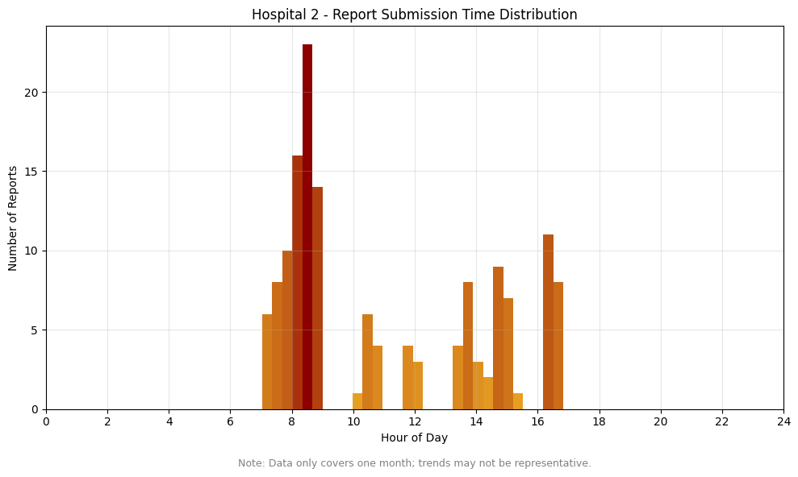
When Dunnit?
Notes:
Slide 9: 15s
We also take a closer look at the specific time, as one dataset provides it. It seems that violence maybe more likely to occur in the morning.
(It is less reliable due to data size and report routine.)

Slide 9
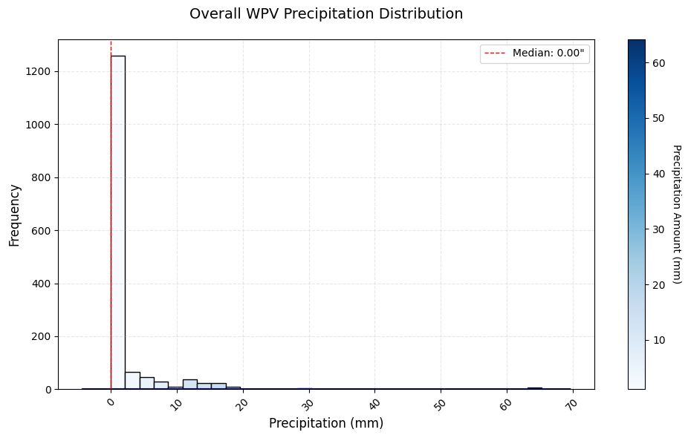
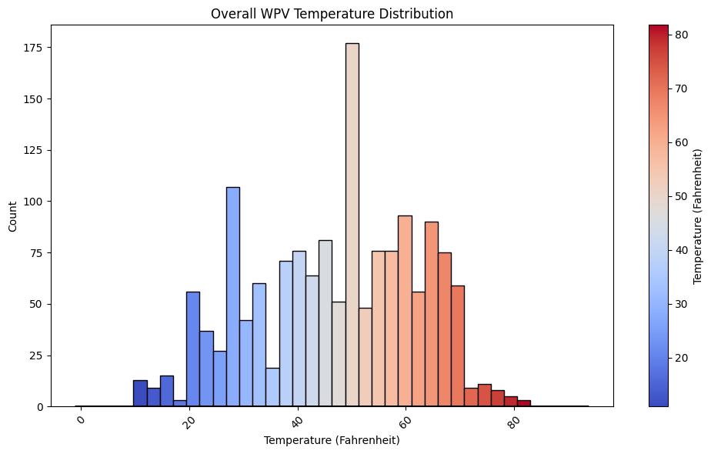
When Dunnit?
Rainy Day Blues?
Seasonal Affective Disorder (SAD)?
……
Notes:
Slide 10: 15s
We also checked the weather pattern.
Fun fact about this part: i used concurrency and lru caching to accelerate the weather checking process, so LeetCode did work!
--------------------------------------
**"Rainy Day Blues"** – A colloquial term for feeling down or irritable due to prolonged rain or gloomy weather.3. **"Seasonal Affective Disorder (SAD)" ** (in some cases) – Though SAD is primarily linked to lack of sunlight in winter, extreme weather can similarly affect mood.
Explain why we want to analyze this part

Slide 10
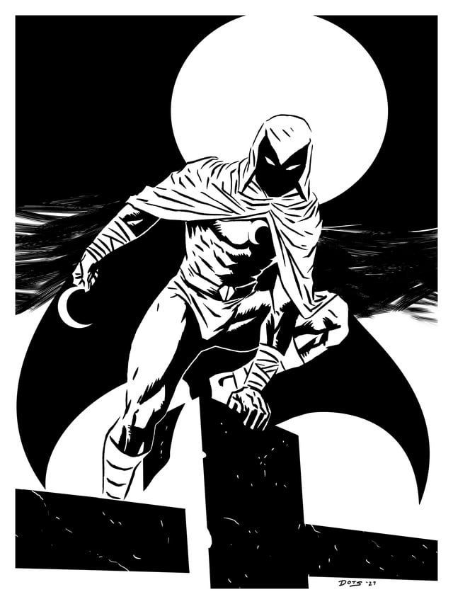
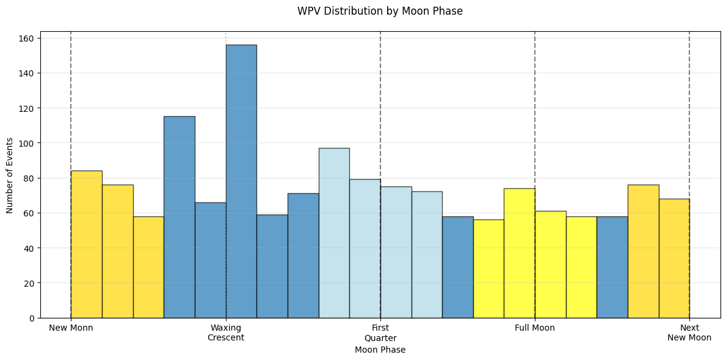
When Dunnit?
Notes:
Slide 11: 20s
And last is the moon phase, which rejects the idea of ‘lunatic’.
A quick summary so far: if you are a nurse working on Thursday in October when its 50F outside, may be consider taking a PTO?

Slide 11
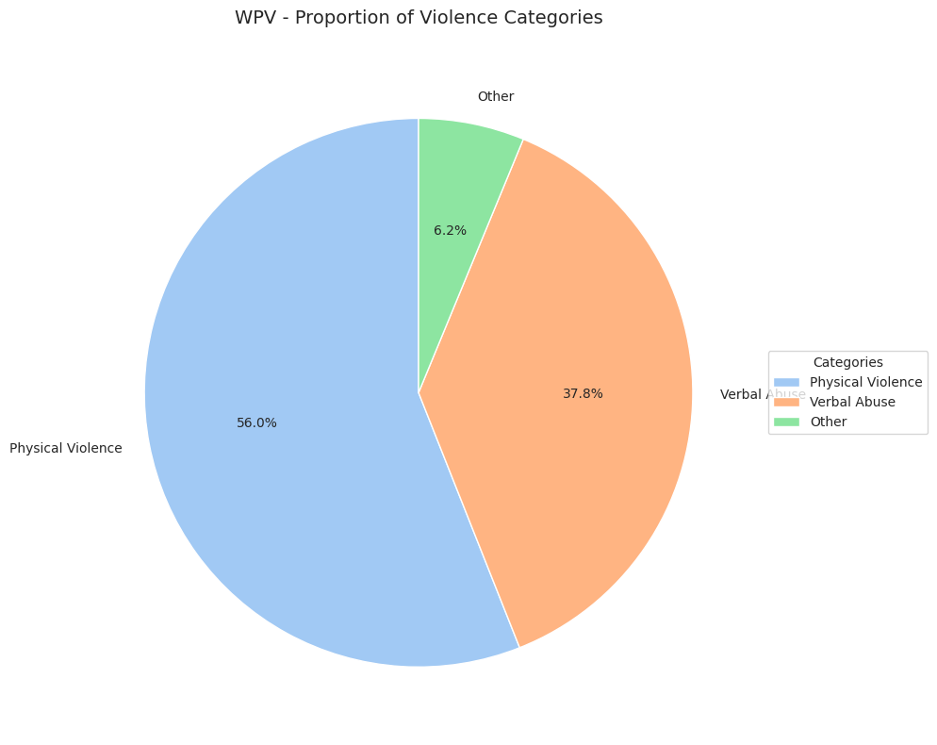
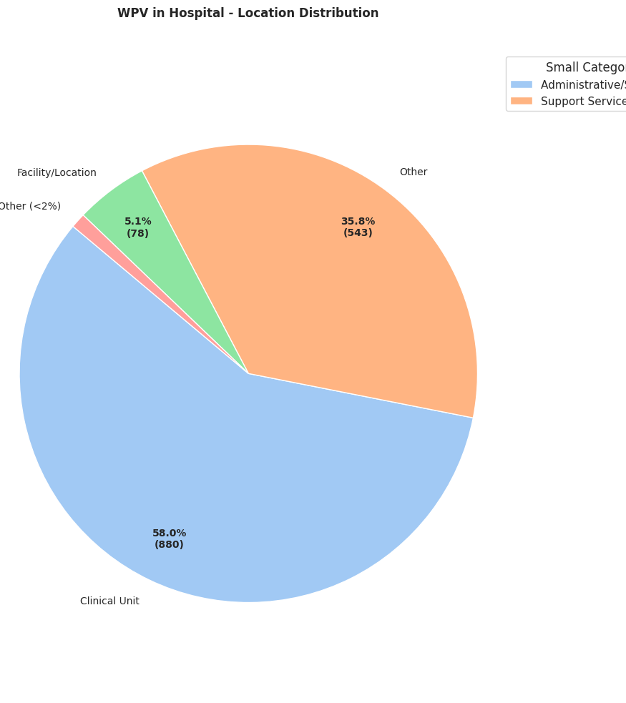
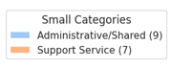
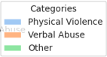
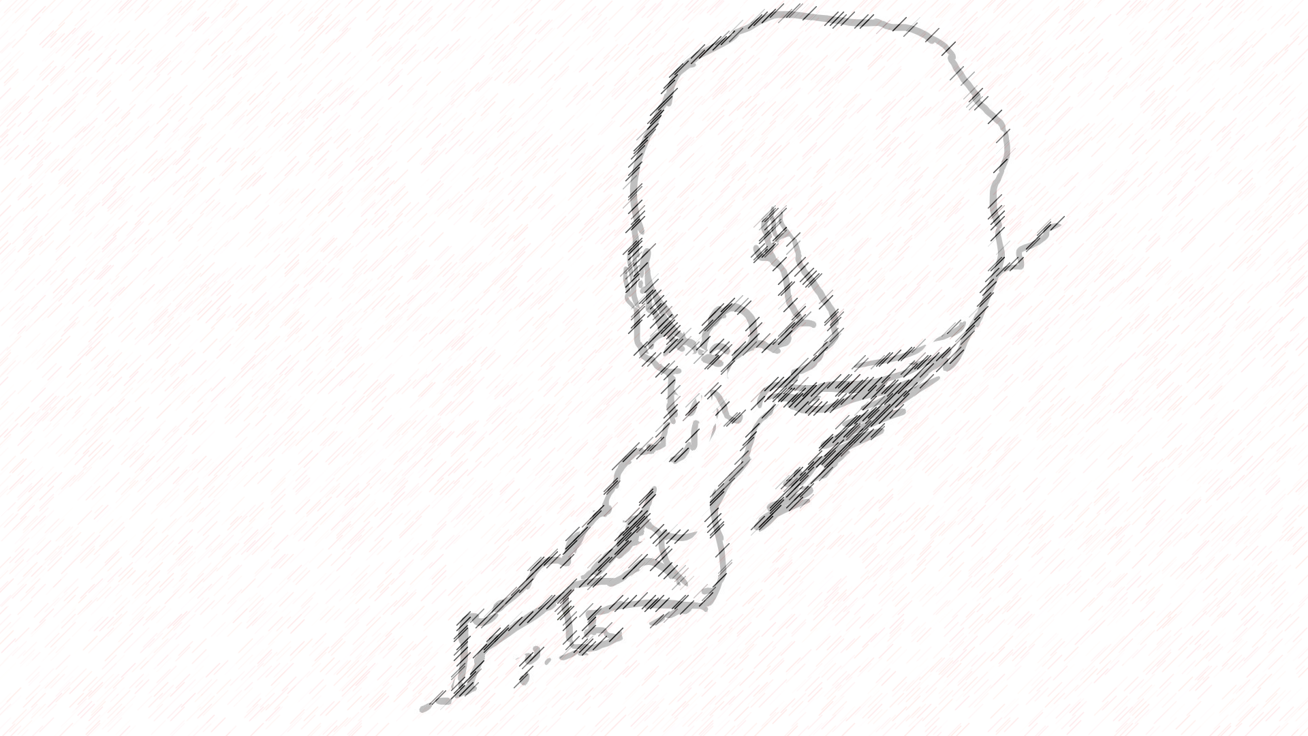
How Dunnit?
Other
Verbal Abuse
Clinical Unit
Notes:
Slide 12: 20s
Next, let’s focus on the location: people in clinical units like ED/ER are definitely living in a hard time, suffering more physical and verbal abuse.
Now let’s step onto a more advanced level.
---------3.5 min

Slide 12
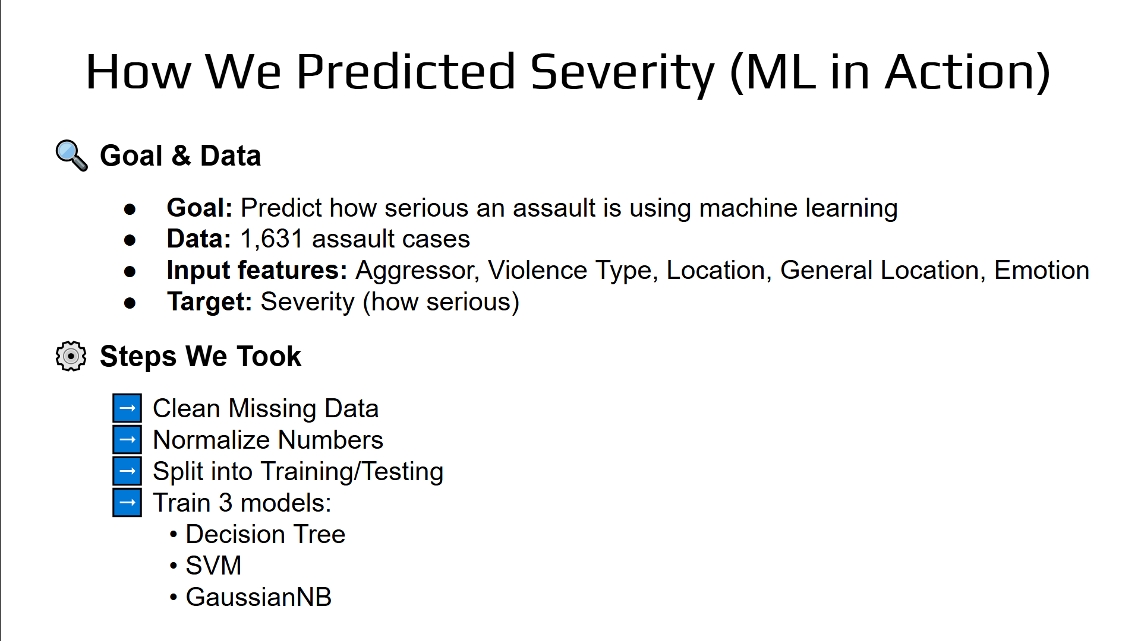
(PLACEHOLDER) The Detective’s Toolkit (ML)
Predicting Severity, Emotions, and Care Needs (no need to predict all in this case, just some possibilities)

Slide 13
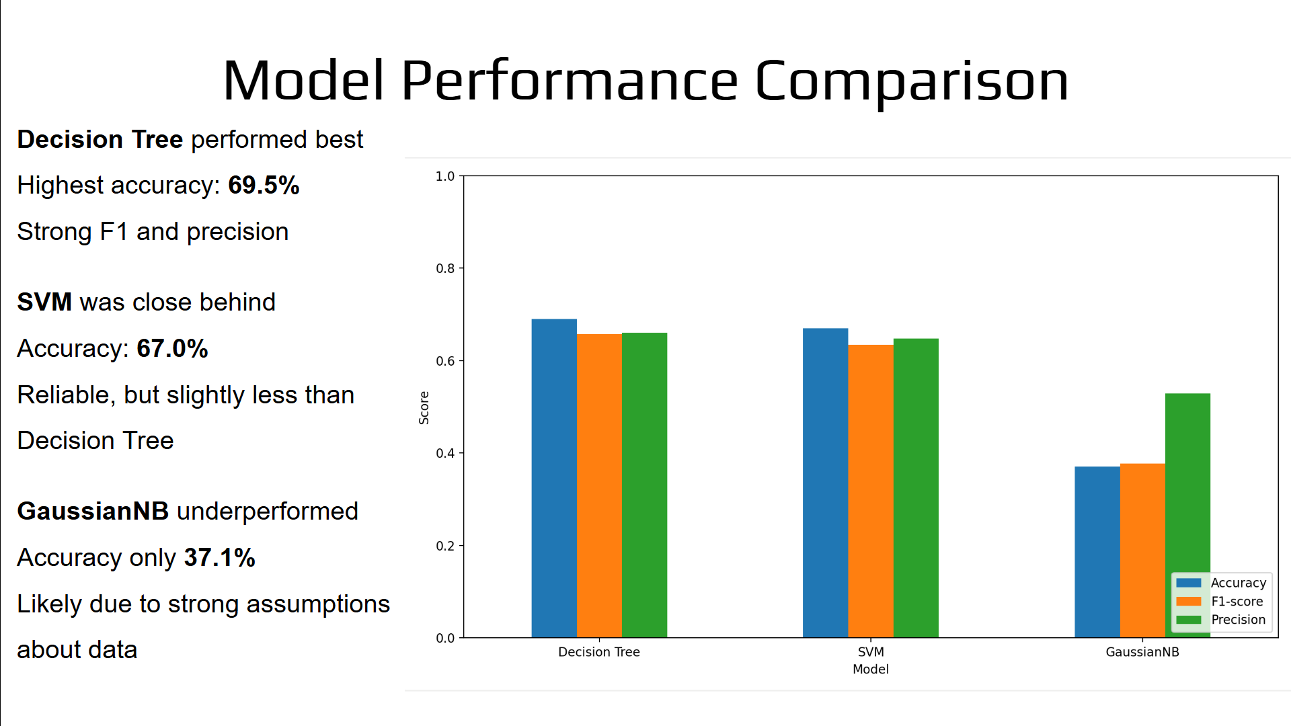

Slide 14
The Cryptic Messages (Semantic Analysis)
Topic Modeling with BERTopic
Clean, group, and name themes
Why BERTopic: better grasp short context
Structured Feature Correlations
Create a correlation matrix to help spot patterns
Kept missing values (np.nan) to avoid losing rare but critical cases
Feature Engineering
Turn topics from BERTopic into binary flags
e.g., “weapon" = 1 if mentioned, 0 otherwise
Ready for advanced machine learning
Notes:
Slide 15: 50s
We also applied semantic analysis to process contributing factors and descriptions.
BERTopic was used to group similar descriptions into themes.
The topic model was actually inspired by the showcase yesterday, in which one project used ClinicalBERT for medical prediction.
Next, we created a correlation matrix to see how variables related to each other, which will be shown in a second.
By combining topics in binary flags with structured data, we are ready for the next level.

Slide 15
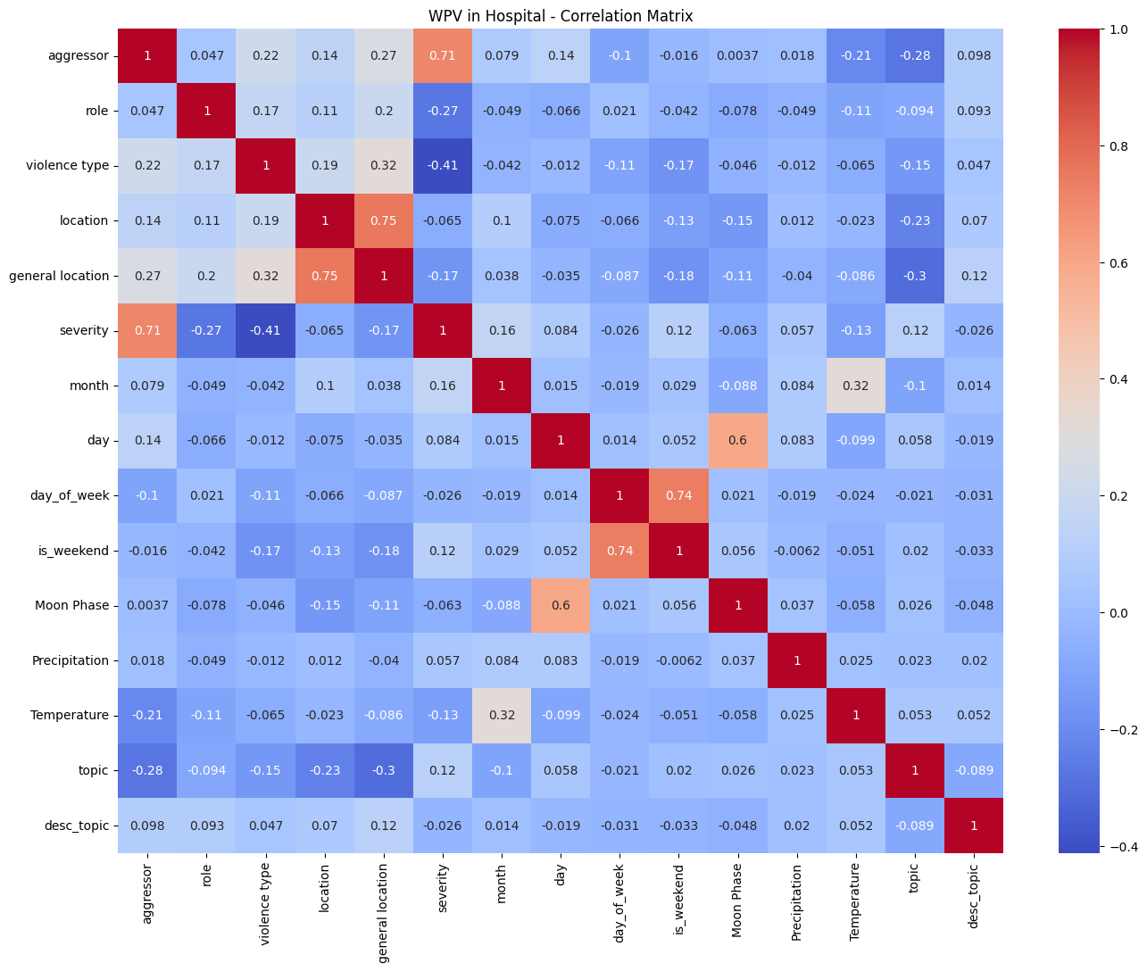
The Cryptic Messages (Semantic Analysis)

Slide 16
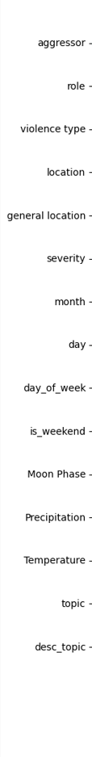
The Cryptic Messages (Semantic Analysis)
+1: Perfect positive correlation
As one increases, the other increases.
-1: Perfect negative correlation
As one increases, the other decreases.
0: No linear correlation
Notes:
Slide 17: 25s
Let’s focus on the severity column.
The `aggressor` feature is the strongest predictor.
Certain types of violence might be associated with lower severity, same for the role of a person involved and higher temperature.
Most features (like `location`, `day`, `month`, `day_of_week`, `Moon Phase`, `topic`) show very weak correlations, which probably don’t significantly influence our target in a linear way.

Slide 17

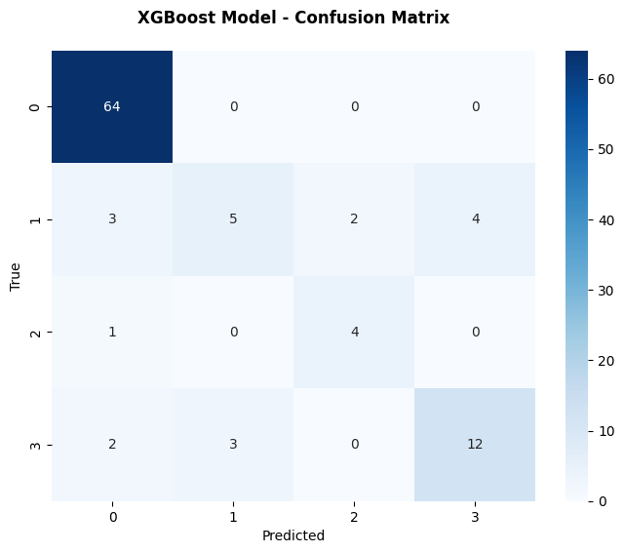
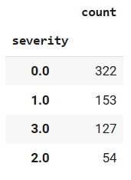
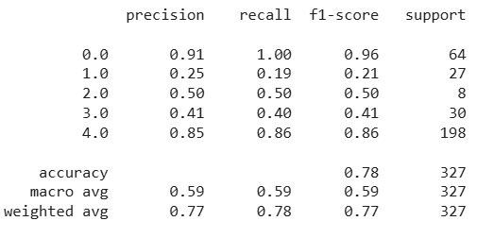
Integrate Semantic Analysis w/ ML
Concern: imbalanced data
Model Choice: XGBoost
Better performance when handling them by weighting errors
Result
Notes:
Slide 18: 50s
Eventually, we combine the semantic result with other structured data and run the XGBoost model.
There is a little concern, as we noticed the data is not balanced.
As a result, the overall success rate is 78%.
The model performs well at spotting "None" (Class 0), with 91% Precision.
However, for class 1 to 3 which represent moderate / mild / severe, the low F1 score means the model struggles with detecting them.
This is likely caused by class imbalance issues as we mentioned earlier.

Slide 18
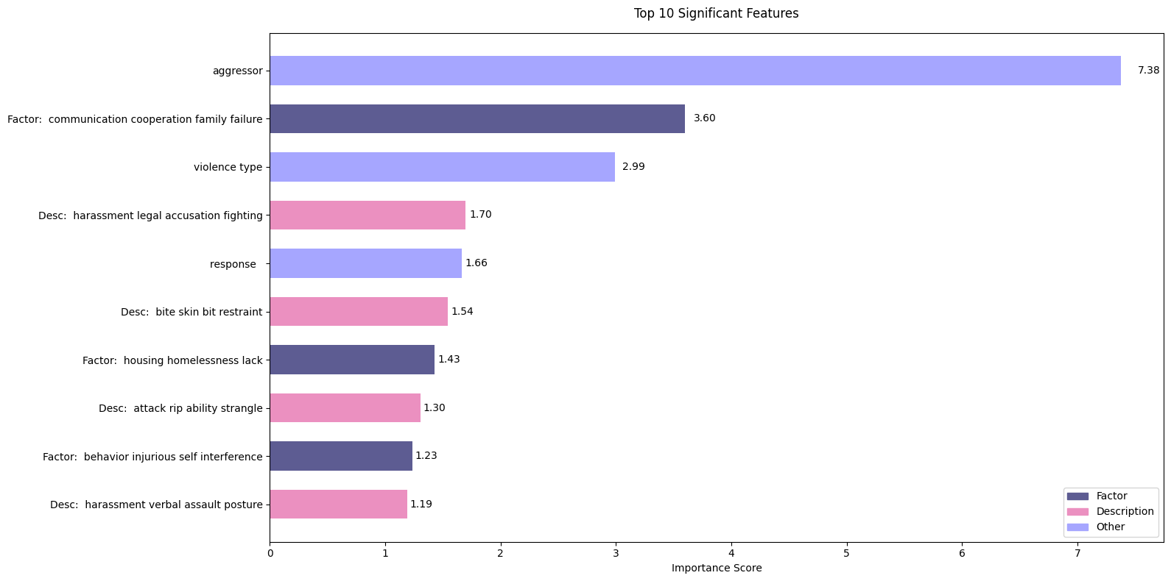


Integrate Semantic Analysis w/ ML
Notes:
Slide 19: 20s
`Aggressor`, `Violence Type` and `text` are the most important factors for model prediction, so definitely keep those fields in the violence report form.

Slide 19

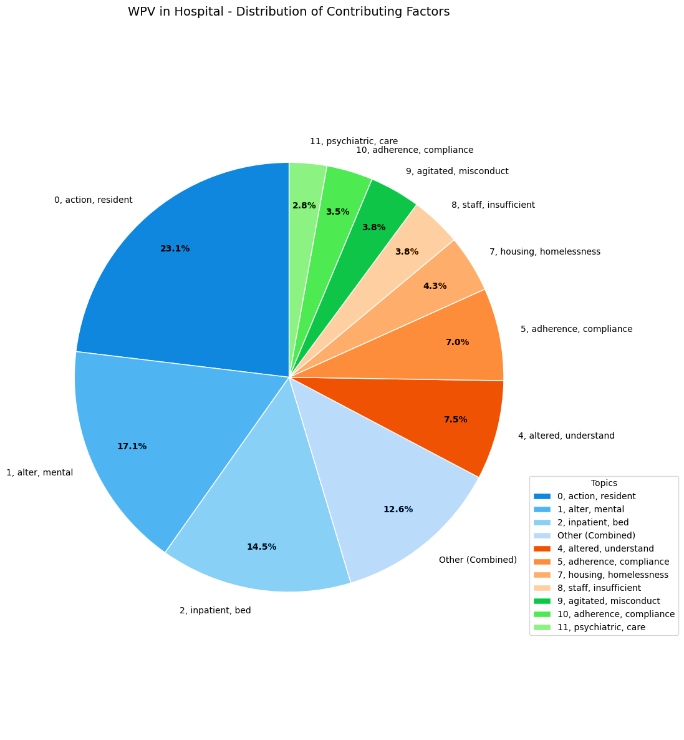
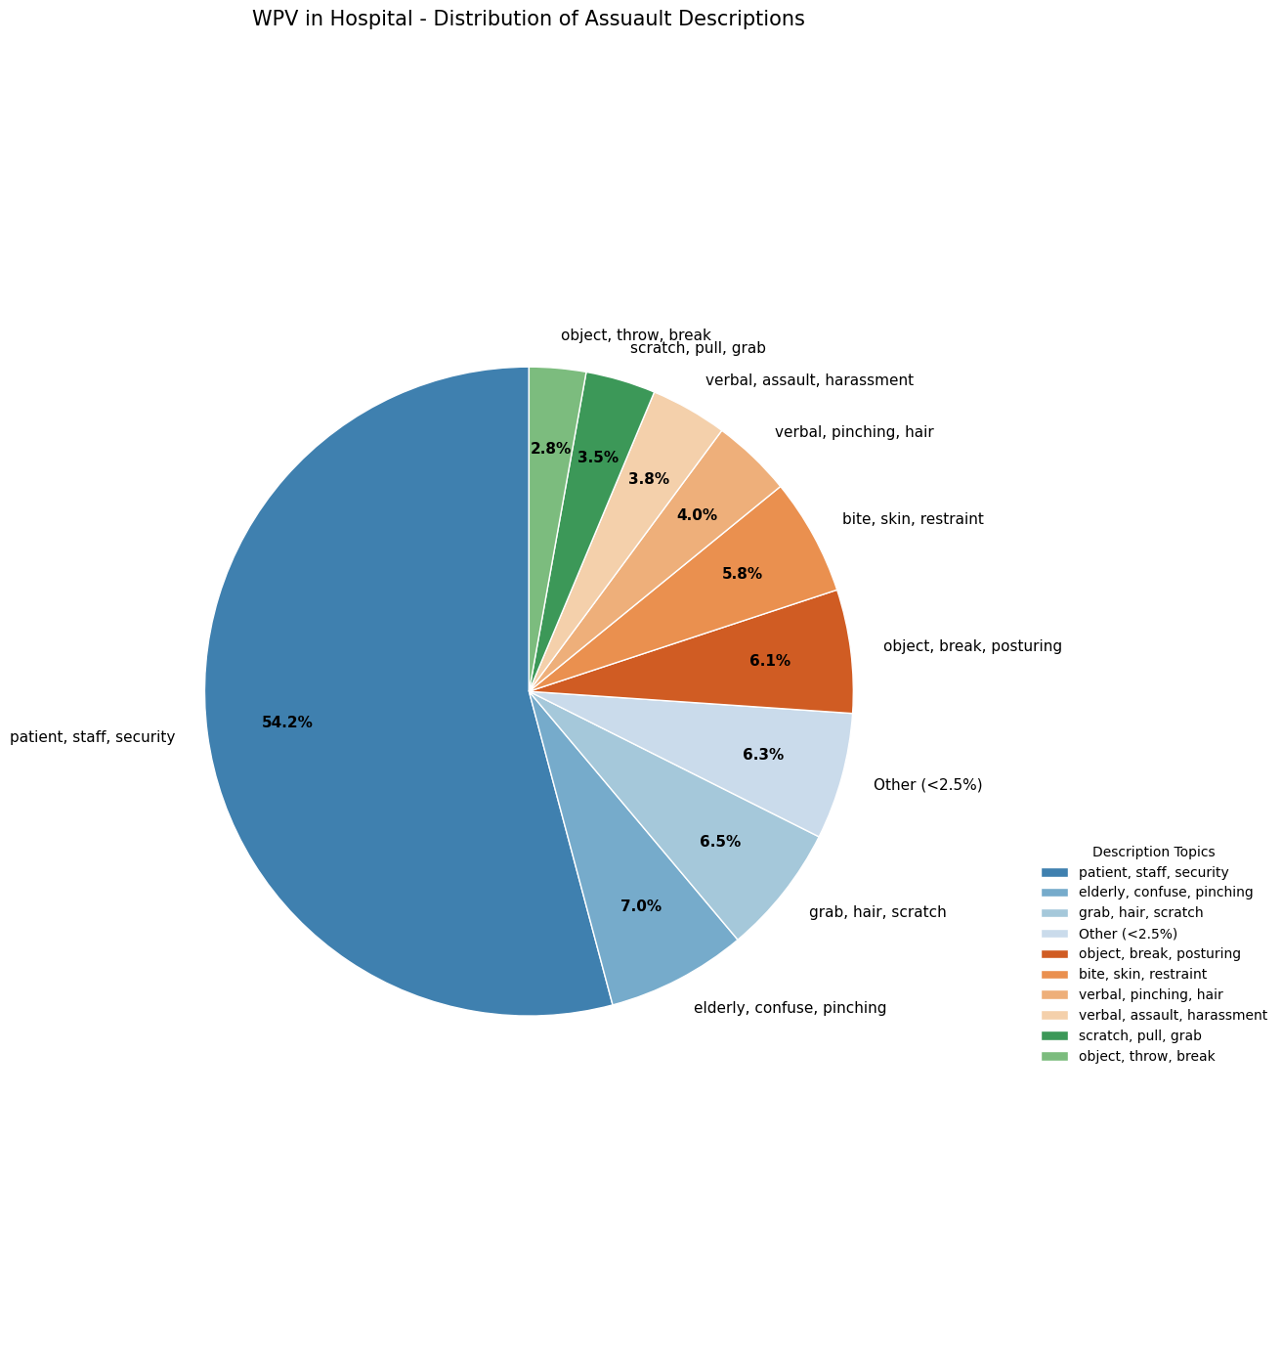
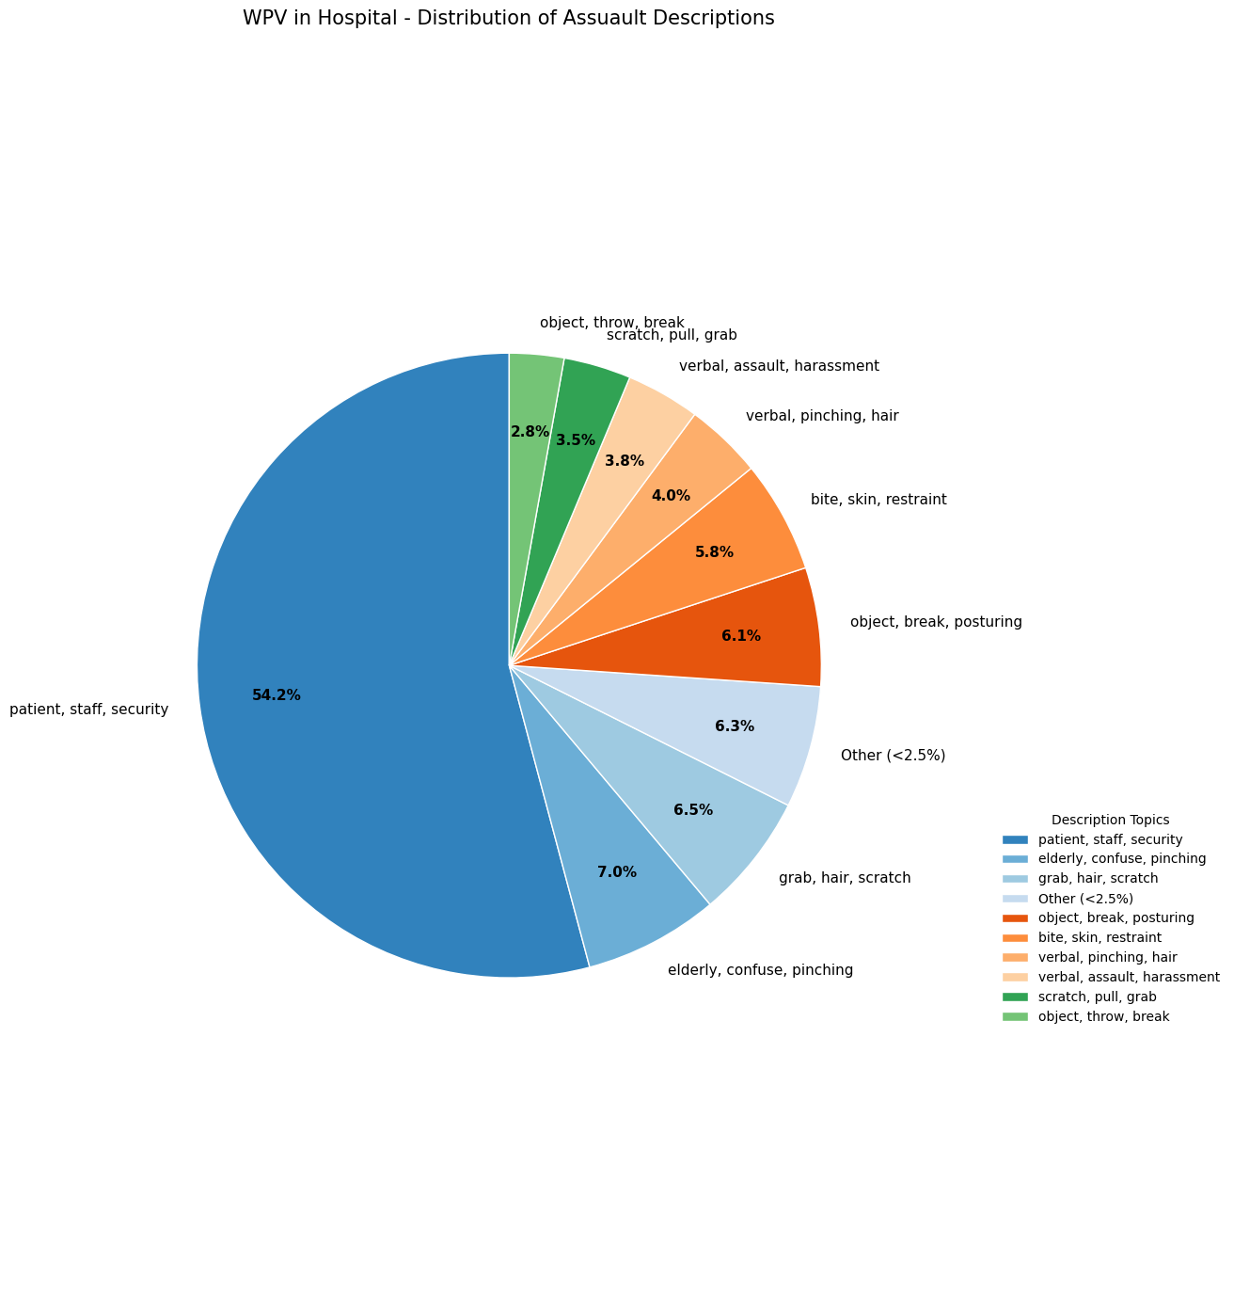
Why Dunnit?
Notes:
Slide 20: 20s
Also we can finally answer the question: why dunnit?
From these two pie charts, we’ve successfully identified `communication`, `mental health challenges`, and `resource limitations` as major root causes.

Slide 20
Guilty As Charged
Most-impacted healthcare professions: nurse
Healthcare settings that have higher rates of physical violence and/or verbal violence: clinical unit (ED/ER & BC)
Specific clinical/situational factors that appear to increase risk of violence: communication breakdowns, mental health challenges, and resource limitations
Policy Recommendations:
De-escalation Training for Stuff
Have Mental Health Professionals in High-Risk Units
Boost Staffing and Resource Allocation
Notes:
Slide 21: 40s
In summary, we were able to answer most questions from our stakeholders.
Nurses are the most-impacted healthcare professions, and clinical units suffer a higher violence rate.
The root causes include communication breakdowns, mental health challenges, and resource limitations.
Therefore, we propose three recommendations: staff training, mental support,and resource allocation.
--------------------------------------
Policy details:
1. Conflict resolution training
2. Have psychiatric nurses or social workers available in:
- Emergency departments,
- Geriatric wards,
- Behavioral health floors.
- Promote real-time intervention instead of reactive response. 3. Boost Staffing and Resource Allocation
- Increase **staffing ratios** especially during peak hours and in psychiatric-adjacent units.
- Provide **on-demand security** for vulnerable staff (e.g., overnight shifts, lone workers).

Slide 21
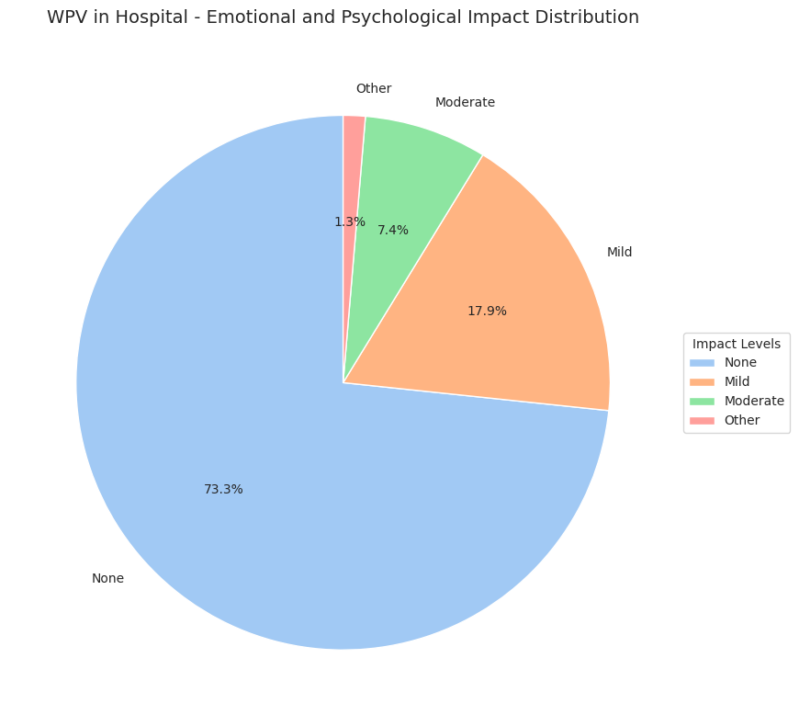
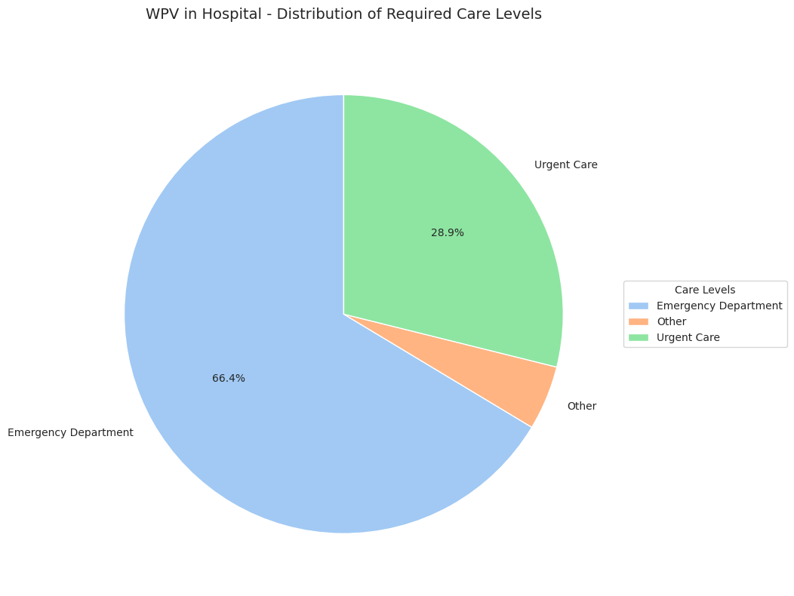
Case Closed?
Analysis: SMOTE for Oversampling
Response & Support
Building a Safer Workplace
Notes:
Slide 22: 30s
But this is not the end.
In terms of future data analysis, we can consider SMOTE for oversampling rare classes.
And in the real world, it’s also important to support those impacted people and to build a safer workplace.
We’d like to thank the instructor and the previous two medical groups for sharing their brilliant insights.
We are open for questions now.

